Slide 1
Dumfries Pressure Zone Elevated Water Storage Tank Project
February 13, 2017
SA Project Manager: David L. Guerra, P.E.
Design Engineer: Hazen & Sawyer

Slide 2
Agenda
Purpose of the Project
Project History
Preliminary Design Parameters
Anticipated Project Duration
Next Steps
Contacts
Q&A

Slide 3
Purpose of the Project
Improve Service and Reliability to the Community
Provides additional storage volume to help maintain system pressures during peak demands
Provides fire protection storage at build-out
Provides emergency storage in the event of a main break or power outage
Improves operational efficiency

Slide 4
Project History
Tank requirement identified in the late 1990’s with the County’s development of the Cherry Hill Sector Plan
Tank shown on the 2003 PWC Comprehensive Plan Map
Tank introduced in the Service Authority’s 2005 Capital Improvement Program
Site easement, access road and water main provided for by the Developer per proffer agreements
Preliminary Engineering Report (PER) completed in October 2016 by the Service Authority’s design consultant

Slide 5
Preliminary Design Parameters
Style
Hydropillar – steel bowl with steel fluted column base (most common style in PW County)
Site will incorporate the Service Authority’s standard security features of fencing and lighting
Size & Dimensions
2 million gallon capacity
Upper bowl diameter about 100 feet
Base diameter about 75 feet
Tank height approximately 115 feet

Slide 6
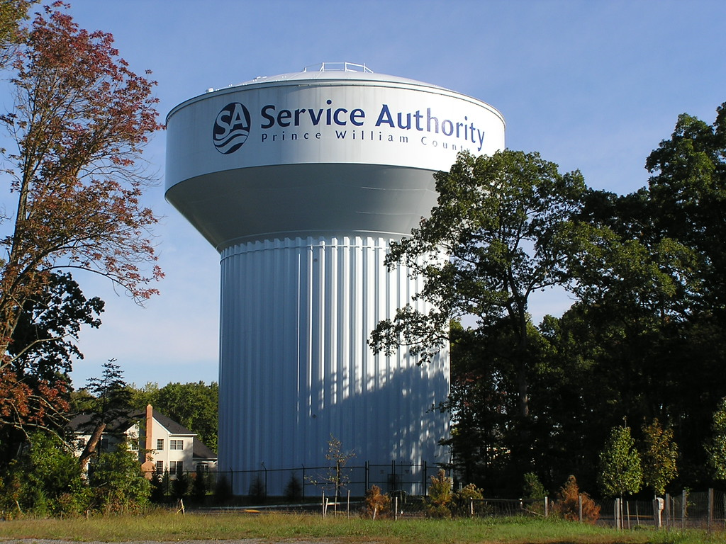
Service Authority’s 2 MG Dominion Valley Tank

Slide 7
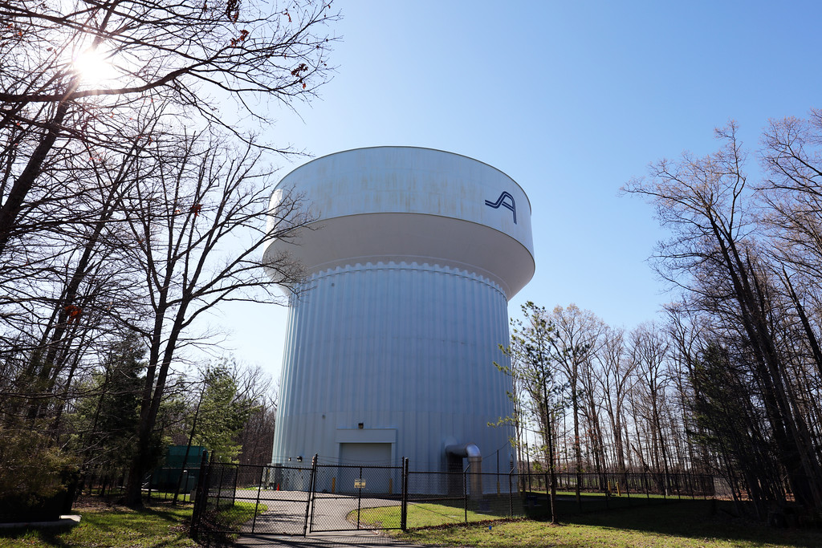
Service Authority’s 2 MG Gainesville Tank

Slide 8
Overall Aerial View
Potomac Shores Pkwy.
River Heritage Blvd.

Slide 9
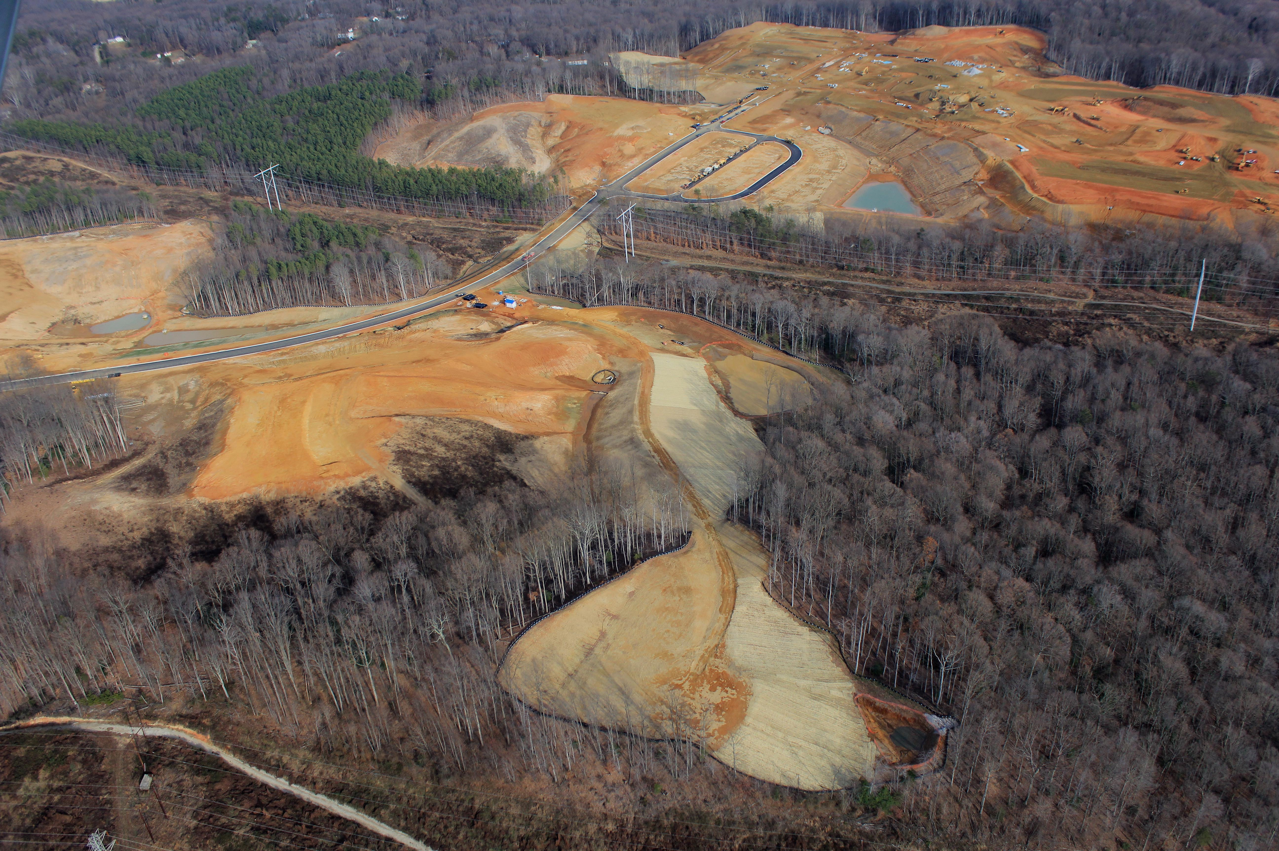
Site Aerial View
River Heritage Blvd.
Tank Site

Slide 10
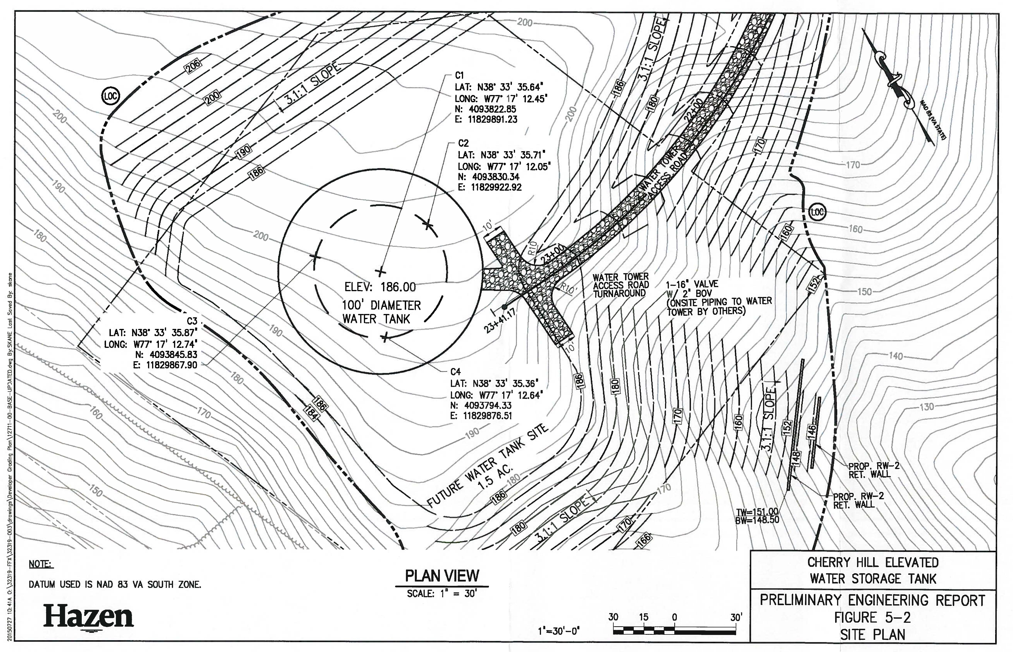
Preliminary Site Layout

Slide 11
Anticipated Project Schedule
Design and Permitting:
March 2017 – February 2019
Community Outreach: Ongoing
PWC Public Facility Review Process:
June 2017 – October 2017
Start of Construction:
Spring 2019
Construction Duration:
18 to 24 Months

Slide 12
Next Steps
Begin Final Design
Start PWC Public Facility Review (PFR) Process
Submit application and documentation showing the project satisfies the intent of the approved comprehensive plan
Hold additional public meetings as needed
County sends out notification of a public meeting to all impacted residents
Public can provide input at Planning Commission meeting
Design continues to meet PFR approval requirements

Slide 13
Contacts
Service Authority’s Community Relations Liaison
Marlo Thomas Watson
571-285-8127
Project Email: dumfriestank@pwcsa.org
Project Website: http://pwcsa.org/dumfries-tank-project

Slide 14
Q & A
Questions?

